Slide 1
Renormalization Group
LEE SungBin

Slide 2
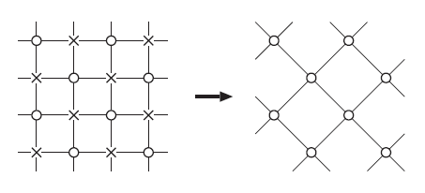
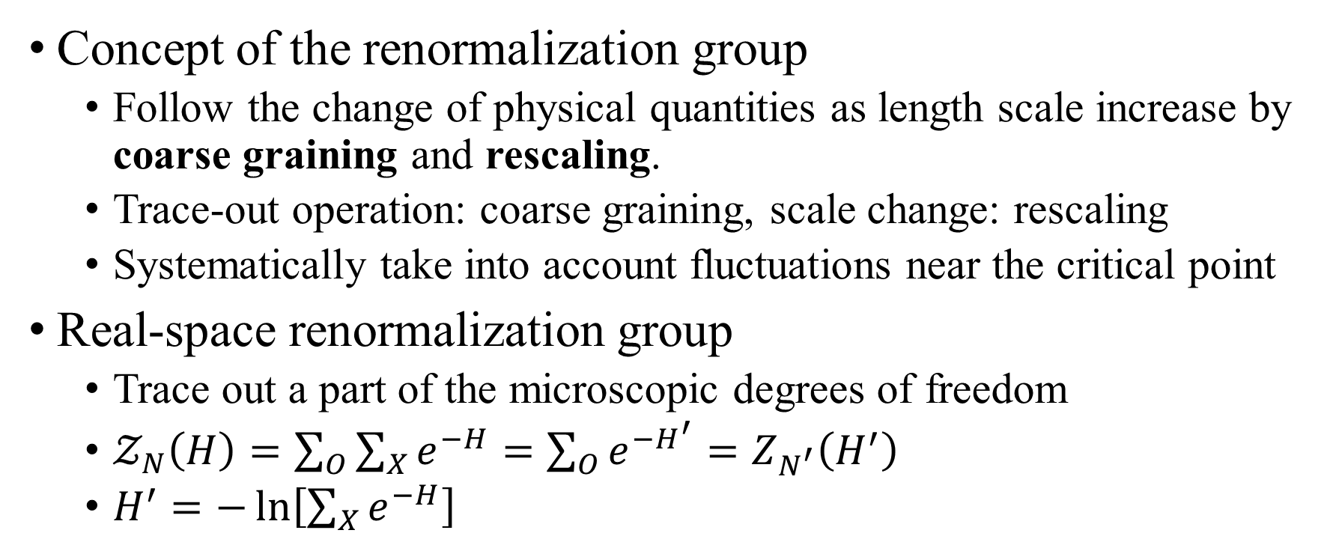
Coarse graining and scale transformation
Concept of the renormalization group
Follow the change of physical quantities as length scale increase by coarse graining and rescaling.
Trace-out operation: coarse graining, scale change: rescaling
Systematically take into account fluctuations near the critical point
Real-space renormalization group
Trace out a part of the microscopic degrees of freedom
$𝒵_{N}\left(H\right)=\sum_{O}{\sum_{X}{e^{−H}}}=\sum_{O}{e^{−H^{′}}}=Z_{N^{′}}\left(H^{′}\right)$
$H^{′}=−\ln\left[\sum_{X}{e^{−H}}\right]$

Slide 3
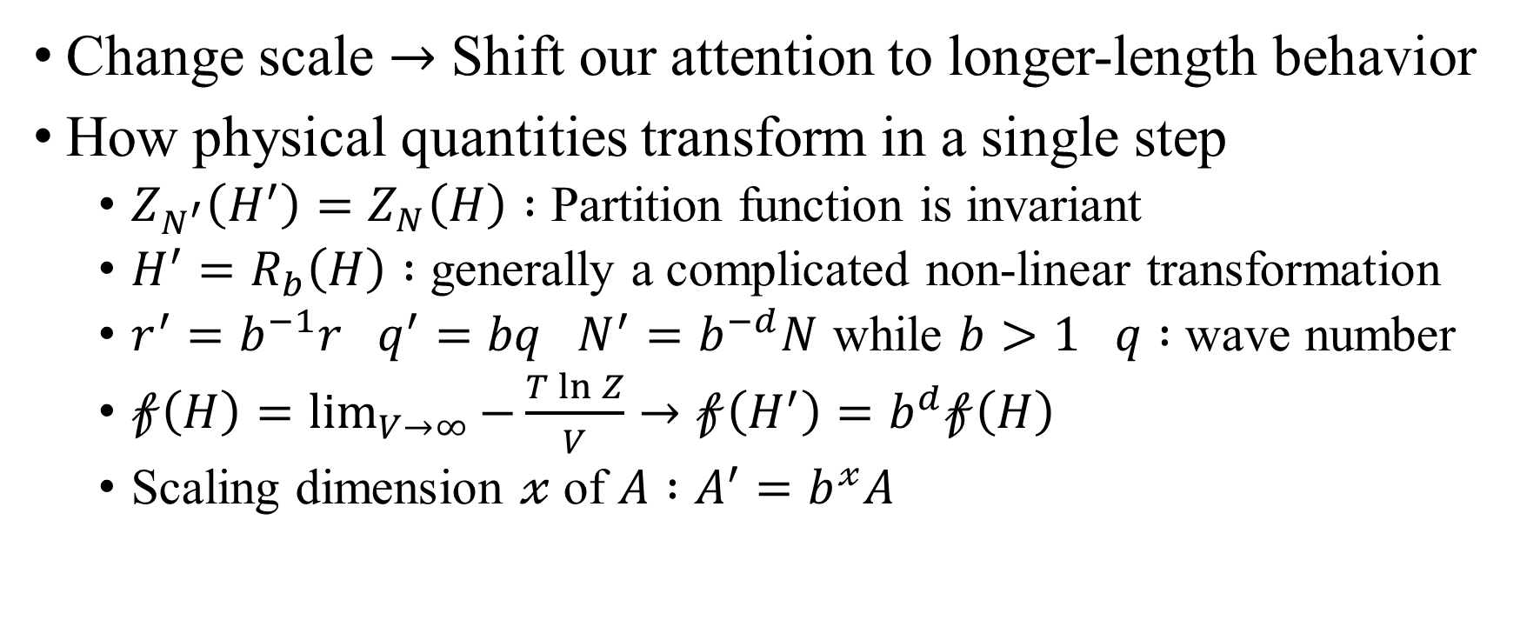
Coarse graining and scale transformation
Change scale $→$ Shift our attention to longer-length behavior
How physical quantities transform in a single step
$Z_{N^{′}}\left(H^{′}\right)=Z_{N}\left(H\right) :$ Partition function is invariant
$H^{′}=R_{b}\left(H\right) :$ generally a complicated non-linear transformation
$r^{′}=b^{−1}r q^{′}=bq N^{′}=b^{−d}N$ while $b>1 q :$ wave number
$𝒻\left(H\right)=\lim_{V→∞}{−\frac{T\ln{Z}}{V}}→𝒻\left(H^{′}\right)=b^{d}𝒻\left(H\right)$
Scaling dimension $𝓍$ of $A :A^{′}=b^{𝓍}A$

Slide 4

Transformation law under scaling
$𝓇^{′}=b^{−1}𝓇$
$∇^{′}=b∇$
$φ^{′}=b^{d−𝓎_{𝒽}}φ$
$𝓉^{′}=b^{𝓎_{𝓉}}𝓉$
$𝒽^{′}=b^{𝓎_{𝒽}}𝒽$

Slide 5
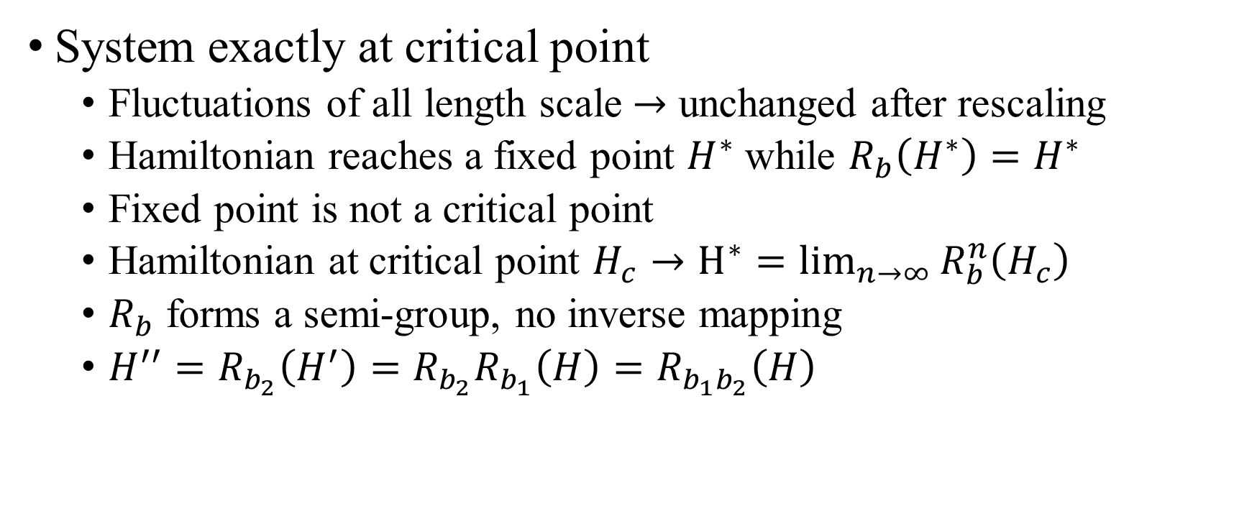
Coarse graining and scale transformation
System exactly at critical point
Fluctuations of all length scale $→$ unchanged after rescaling
Hamiltonian reaches a fixed point $H^{∗}$ while $R_{b}\left(H^{∗}\right)=H^{∗}$
Fixed point is not a critical point
Hamiltonian at critical point $H_{c}→H^{∗}=\lim_{n→∞}{R_{b}^{n}\left(H_{c}\right)}$
$R_{b}$ forms a semi-group, no inverse mapping
$H^{′′}=R_{b_{2}}\left(H^{′}\right)=R_{b_{2}}R_{b_{1}}\left(H\right)=R_{b_{1}b_{2}}\left(H\right)$

Slide 6
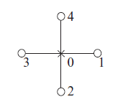
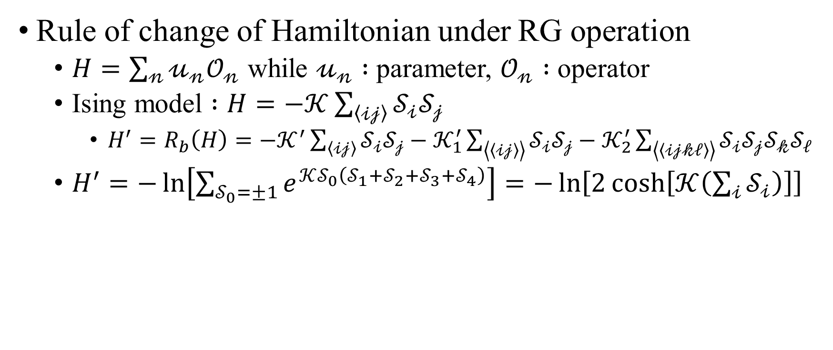
Parameter space and RG equation
Rule of change of Hamiltonian under RG operation
$H=\sum_{𝓃}{𝓊_{𝓃}𝒪_{𝓃}}$ while $𝓊_{𝓃} :$ parameter, $𝒪_{𝓃} :$ operator
Ising model $:H=−𝒦\sum_{\left\langle 𝒾𝒿\right\rangle }{𝒮_{𝒾}𝒮_{𝒿}}$
$H^{′}=R_{b}\left(H\right)=−𝒦^{′}\sum_{\left\langle 𝒾𝒿\right\rangle }{𝒮_{𝒾}𝒮_{𝒿}}−𝒦_{1}^{′}\sum_{\left\langle \left\langle 𝒾𝒿\right\rangle \right\rangle }{𝒮_{𝒾}𝒮_{𝒿}}−𝒦_{2}^{′}\sum_{\left\langle \left\langle 𝒾𝒿𝓀ℓ\right\rangle \right\rangle }{𝒮_{𝒾}𝒮_{𝒿}𝒮_{𝓀}𝒮_{ℓ}}$
$H^{′}=−\ln\left[\sum_{𝒮_{0}=±1}{e^{𝒦𝒮_{0}\left(𝒮_{1}+𝒮_{2}+𝒮_{3}+𝒮_{4}\right)}}\right]=−\ln\left[2\cosh\left[𝒦\left(\sum_{𝒾}{𝒮_{𝒾}}\right)\right]\right]$

Slide 7

Parameter space and RG equation
$f\left(𝓍\right)=\ln\left[\cosh\left(𝓍\right)\right]=\sum_{𝓃}{𝒶_{𝓃}𝓍^{𝓃}}$
$f\left(−𝓍\right)=f\left(𝓍\right)→f\left(x\right)=\sum_{𝓃}{𝒶_{2𝓃}𝓍^{2𝓃}}$
$\ln\left[\cosh\left(𝓍\right)\right]=𝓍^{2}+𝒶_{4}𝓍^{4}+…$

Slide 8
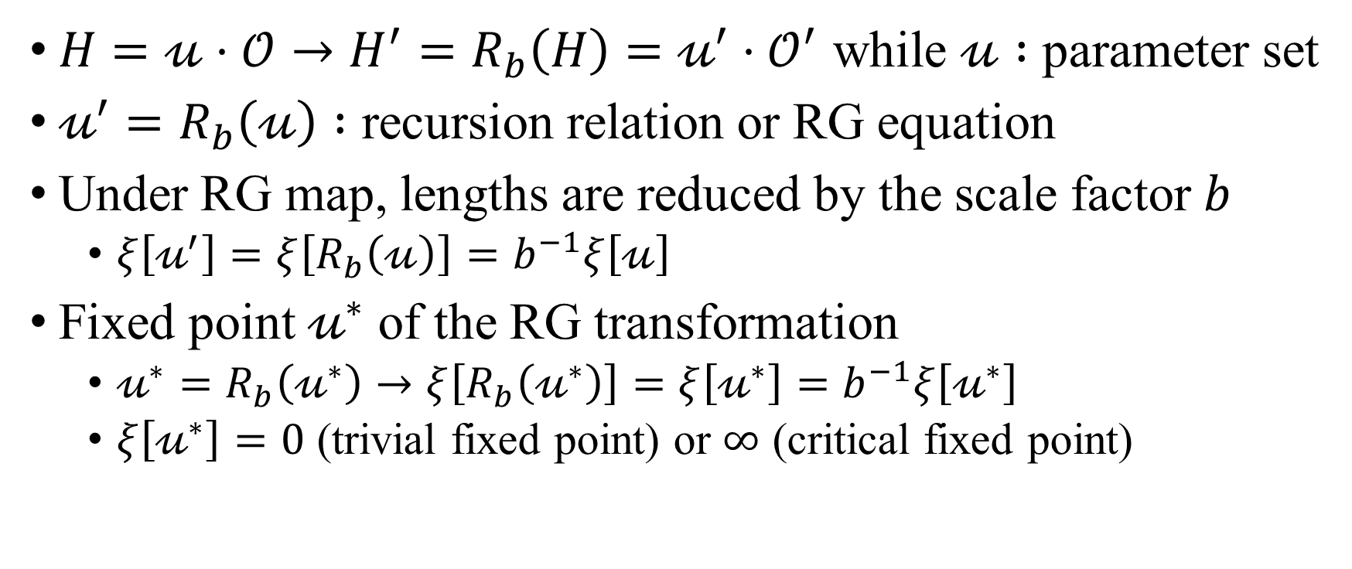
Parameter space and RG equation
$H=𝓊⋅𝒪→H^{′}=R_{b}\left(H\right)=𝓊^{′}⋅𝒪^{′}$ while $𝓊 :$ parameter set
$𝓊^{′}=R_{b}\left(𝓊\right) :$ recursion relation or RG equation
Under RG map, lengths are reduced by the scale factor $b$
$ξ\left[𝓊^{′}\right]=ξ\left[R_{b}\left(𝓊\right)\right]=b^{−1}ξ\left[𝓊\right]$
Fixed point $𝓊^{∗}$ of the RG transformation
$𝓊^{∗}=R_{b}\left(𝓊^{∗}\right)→ξ\left[R_{b}\left(𝓊^{∗}\right)\right]=ξ\left[𝓊^{∗}\right]=b^{−1}ξ\left[𝓊^{∗}\right]$
$ξ\left[𝓊^{∗}\right]=0$ (trivial fixed point) or $∞$ (critical fixed point)

Slide 9
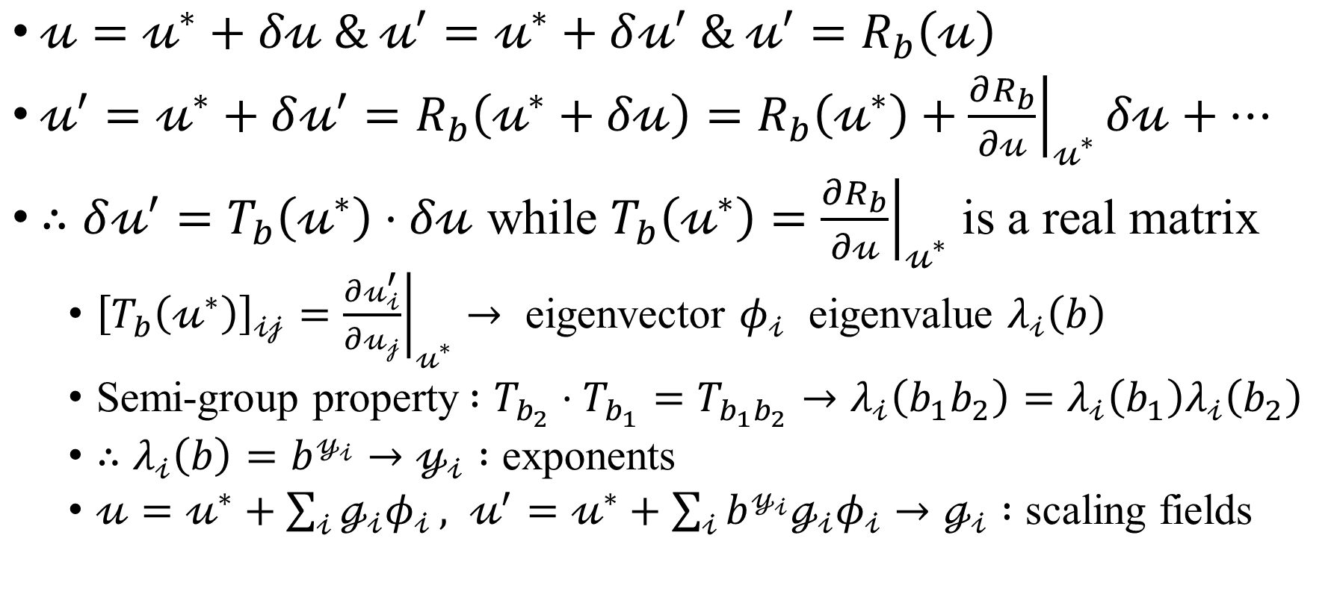
Properties near a critical fixed point
$𝓊=𝓊^{∗}+δ𝓊 \& 𝓊^{′}=𝓊^{∗}+δ𝓊^{′} \& 𝓊^{′}=R_{b}\left(𝓊\right)$
$𝓊^{′}=𝓊^{∗}+δ𝓊^{′}=R_{b}\left(𝓊^{∗}+δ𝓊\right)=R_{b}\left(𝓊^{∗}\right)+{\left.\frac{∂R_{b}}{∂𝓊}\right|}_{𝓊^{∗}}δ𝓊+…$
$∴δ𝓊^{′}=T_{b}\left(𝓊^{∗}\right)⋅δ𝓊$ while $T_{b}\left(𝓊^{∗}\right)={\left.\frac{∂R_{b}}{∂𝓊}\right|}_{𝓊^{∗}}$ is a real matrix
${\left[T_{b}\left(𝓊^{∗}\right)\right]}_{𝒾𝒿}={\left.\frac{∂𝓊_{𝒾}^{′}}{∂𝓊_{𝒿}}\right|}_{𝓊^{∗}}→$ eigenvector $φ_{𝒾}$ eigenvalue $λ_{𝒾}\left(b\right)$
Semi-group property$:T_{b_{2}}⋅T_{b_{1}}=T_{b_{1}b_{2}}→λ_{𝒾}\left(b_{1}b_{2}\right)=λ_{𝒾}\left(b_{1}\right)λ_{𝒾}\left(b_{2}\right)$
$∴λ_{𝒾}\left(b\right)=b^{𝓎_{𝒾}}→𝓎_{𝒾} :$ exponents
$𝓊=𝓊^{∗}+\sum_{𝒾}{ℊ_{𝒾}φ_{𝒾}}, 𝓊^{′}=𝓊^{∗}+\sum_{𝒾}{b^{𝓎_{𝒾}}ℊ_{𝒾}φ_{𝒾}}→ℊ_{𝒾} :$ scaling fields

Slide 10
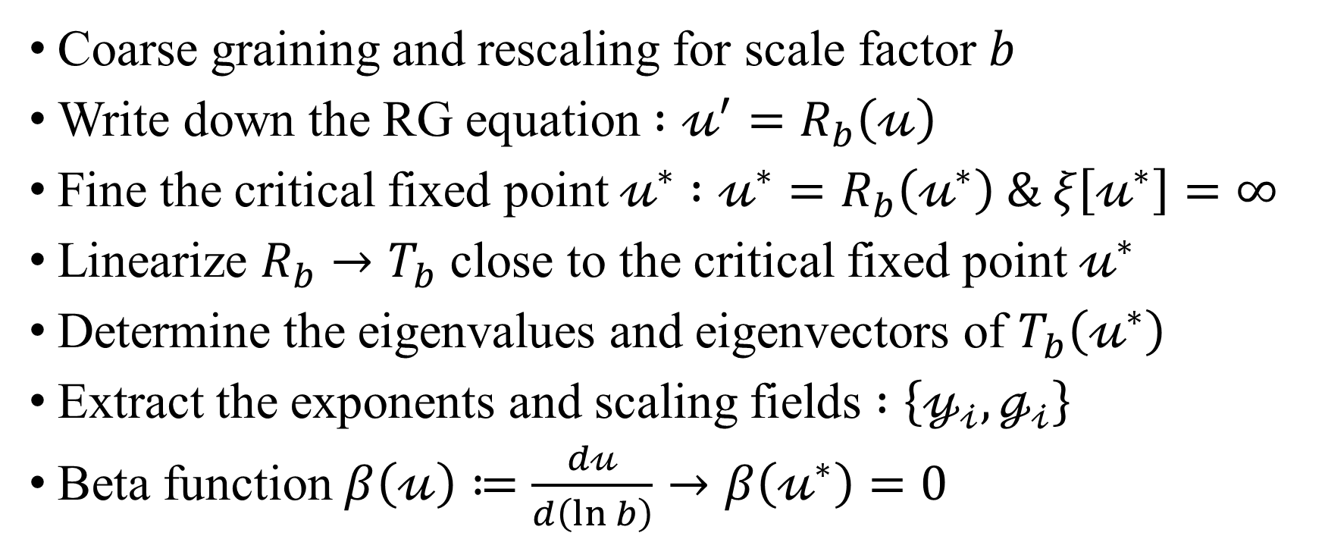
Renormalization group procedure
Coarse graining and rescaling for scale factor $b$
Write down the RG equation $:𝓊^{′}=R_{b}\left(𝓊\right)$
Fine the critical fixed point $𝓊^{∗}$ $:𝓊^{∗}=R_{b}\left(𝓊^{∗}\right) \& ξ\left[𝓊^{∗}\right]=∞$
Linearize $R_{b}→T_{b}$ close to the critical fixed point $𝓊^{∗}$
Determine the eigenvalues and eigenvectors of $T_{b}\left(𝓊^{∗}\right)$
Extract the exponents and scaling fields $:\left\{𝓎_{𝒾},ℊ_{𝒾}\right\}$
Beta function $β\left(𝓊\right)≔\frac{d𝓊}{d\left(\ln{b}\right)}→β\left(𝓊^{∗}\right)=0$

Slide 11
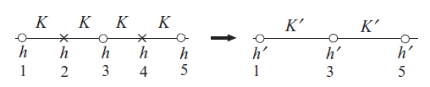
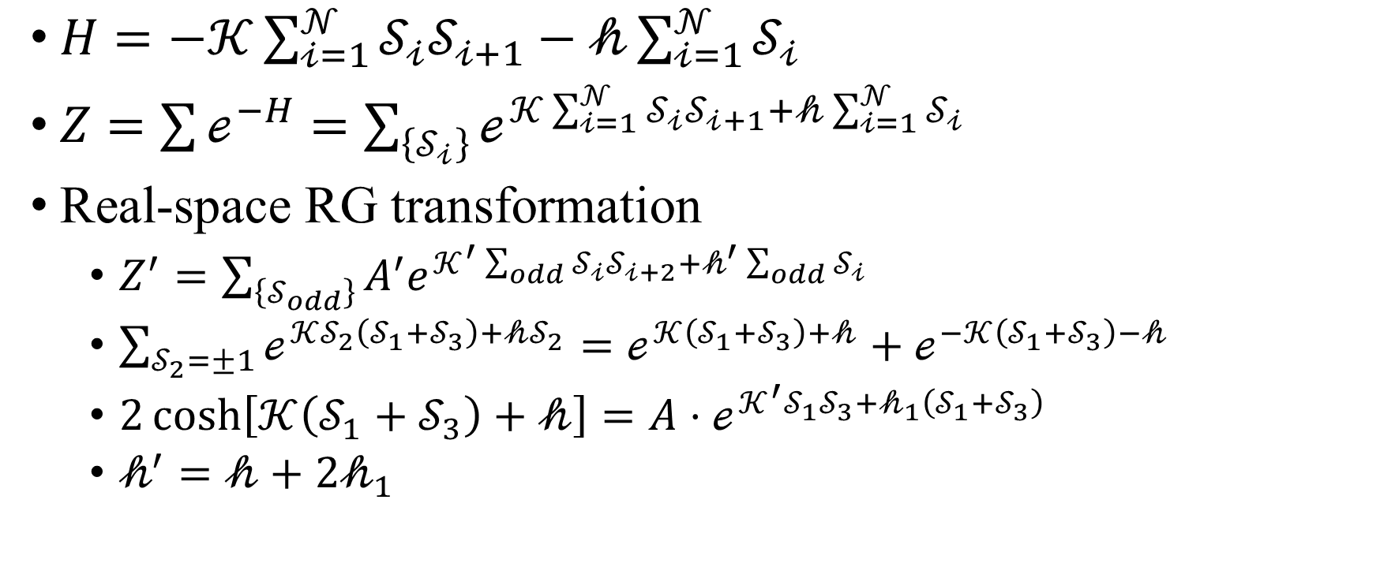
Example: one-dimensional Ising model
$H=−𝒦\sum_{𝒾=1}^{𝒩}{𝒮_{𝒾}𝒮_{𝒾+1}}−𝒽\sum_{𝒾=1}^{𝒩}{𝒮_{𝒾}}$
$Z=\sum{ℯ^{−H}}=\sum_{\left\{𝒮_{𝒾}\right\}}{ℯ^{𝒦\sum_{𝒾=1}^{𝒩}{𝒮_{𝒾}𝒮_{𝒾+1}}+𝒽\sum_{𝒾=1}^{𝒩}{𝒮_{𝒾}}}}$
Real-space RG transformation
$Z^{′}=\sum_{\left\{𝒮_{odd}\right\}}{A^{′}e^{𝒦^{′}\sum_{odd}{𝒮_{𝒾}𝒮_{𝒾+2}}+𝒽^{′}\sum_{odd}{𝒮_{𝒾}}}}$
$\sum_{𝒮_{2}=±1}{ℯ^{𝒦𝒮_{2}\left(𝒮_{1}+𝒮_{3}\right)+𝒽𝒮_{2}}}=ℯ^{𝒦\left(𝒮_{1}+𝒮_{3}\right)+𝒽}+ℯ^{−𝒦\left(𝒮_{1}+𝒮_{3}\right)−𝒽}$
$2\cosh\left[𝒦\left(𝒮_{1}+𝒮_{3}\right)+𝒽\right]=A⋅ℯ^{𝒦^{′}𝒮_{1}𝒮_{3}+𝒽_{1}\left(𝒮_{1}+𝒮_{3}\right)}$
$𝒽^{′}=𝒽+2𝒽_{1}$

Slide 12
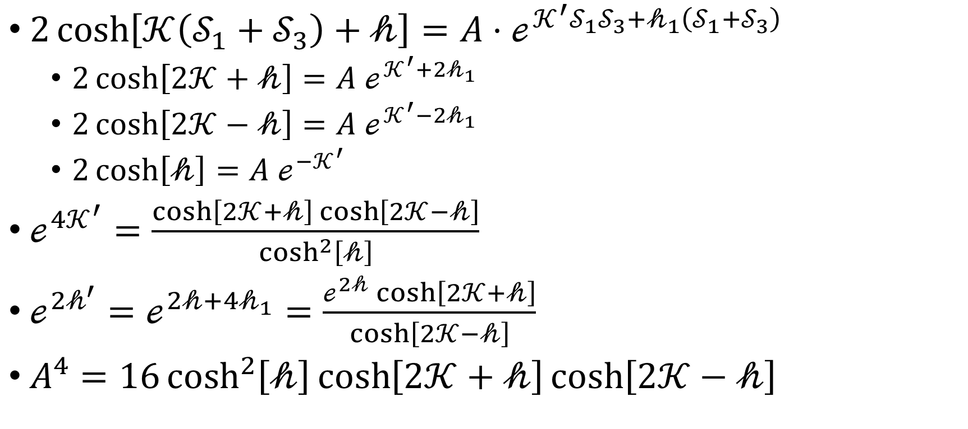
Example: one-dimensional Ising model
$2\cosh\left[𝒦\left(𝒮_{1}+𝒮_{3}\right)+𝒽\right]=A⋅ℯ^{𝒦^{′}𝒮_{1}𝒮_{3}+𝒽_{1}\left(𝒮_{1}+𝒮_{3}\right)}$
$2\cosh\left[2𝒦+𝒽\right]=A ℯ^{𝒦^{′}+2𝒽_{1}}$
$2\cosh\left[2𝒦−𝒽\right]=A ℯ^{𝒦^{′}−2𝒽_{1}}$
$2\cosh\left[𝒽\right]=A ℯ^{−𝒦^{′}}$
$ℯ^{4𝒦^{′}}=\frac{\cosh\left[2𝒦+𝒽\right]\cosh\left[2𝒦−𝒽\right]}{\cosh^{2}\left[𝒽\right]}$
$ℯ^{2𝒽^{′}}=ℯ^{2𝒽+4𝒽_{1}}=\frac{ℯ^{2𝒽}\cosh\left[2𝒦+𝒽\right]}{\cosh\left[2𝒦−𝒽\right]}$
$A^{4}=16\cosh^{2}\left[𝒽\right]\cosh\left[2𝒦+𝒽\right]\cosh\left[2𝒦−𝒽\right]$

Slide 13
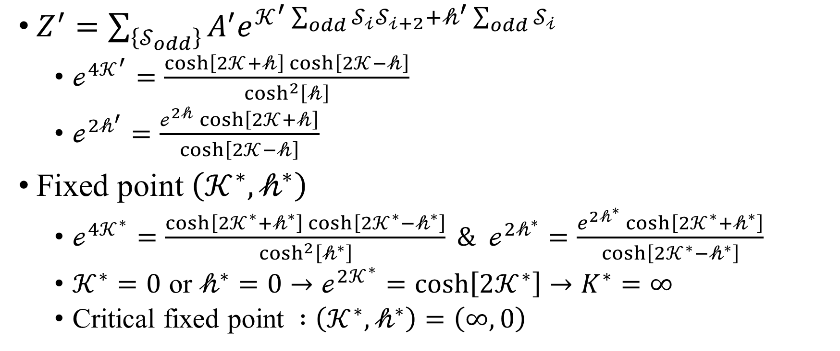
Example: one-dimensional Ising model
$Z^{′}=\sum_{\left\{𝒮_{odd}\right\}}{A^{′}e^{𝒦^{′}\sum_{odd}{𝒮_{𝒾}𝒮_{𝒾+2}}+𝒽^{′}\sum_{odd}{𝒮_{𝒾}}}}$
$ℯ^{4𝒦^{′}}=\frac{\cosh\left[2𝒦+𝒽\right]\cosh\left[2𝒦−𝒽\right]}{\cosh^{2}\left[𝒽\right]}$
$ℯ^{2𝒽^{′}}=\frac{ℯ^{2𝒽}\cosh\left[2𝒦+𝒽\right]}{\cosh\left[2𝒦−𝒽\right]}$
Fixed point $\left(𝒦^{∗},𝒽^{∗}\right)$
$ℯ^{4𝒦^{∗}}=\frac{\cosh\left[2𝒦^{∗}+𝒽^{∗}\right]\cosh\left[2𝒦^{∗}−𝒽^{∗}\right]}{\cosh^{2}\left[𝒽^{∗}\right]} \& ℯ^{2𝒽^{∗}}=\frac{e^{2𝒽^{∗}}\cosh\left[2𝒦^{∗}+𝒽^{∗}\right]}{\cosh\left[2𝒦^{∗}−𝒽^{∗}\right]}$
$𝒦^{∗}=0$ or $𝒽^{∗}=0→ℯ^{2𝒦^{∗}}=\cosh\left[2𝒦^{∗}\right]→K^{∗}=∞$
Critical fixed point $:\left(𝒦^{∗},𝒽^{∗}\right)=\left(∞,0\right)$

Slide 14
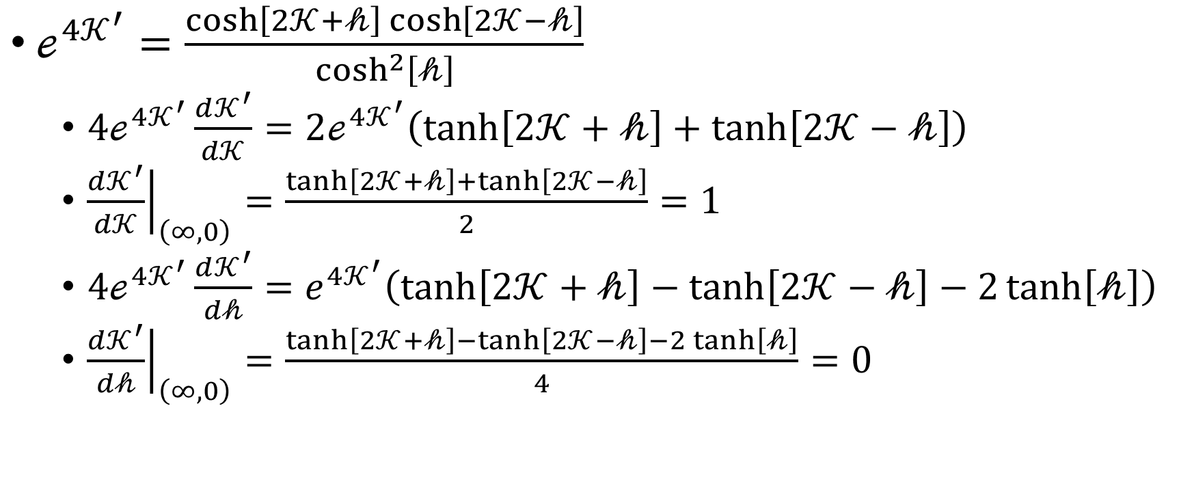
Example: one-dimensional Ising model
$ℯ^{4𝒦^{′}}=\frac{\cosh\left[2𝒦+𝒽\right]\cosh\left[2𝒦−𝒽\right]}{\cosh^{2}\left[𝒽\right]}$
$4ℯ^{4𝒦^{′}}\frac{d𝒦^{′}}{d𝒦}=2ℯ^{4𝒦^{′}}\left(\tanh\left[2𝒦+𝒽\right]+\tanh\left[2𝒦−𝒽\right]\right)$
${\left.\frac{d𝒦^{′}}{d𝒦}\right|}_{\left(∞,0\right)}=\frac{\tanh\left[2𝒦+𝒽\right]+\tanh\left[2𝒦−𝒽\right]}{2}=1$
$4ℯ^{4𝒦^{′}}\frac{d𝒦^{′}}{d𝒽}=e^{4𝒦^{′}}\left(\tanh\left[2𝒦+𝒽\right]−\tanh\left[2𝒦−𝒽\right]−2\tanh\left[𝒽\right]\right)$
${\left.\frac{d𝒦^{′}}{d𝒽}\right|}_{\left(∞,0\right)}=\frac{\tanh\left[2𝒦+𝒽\right]−\tanh\left[2𝒦−𝒽\right]−2\tanh\left[𝒽\right]}{4}=0$

Slide 15
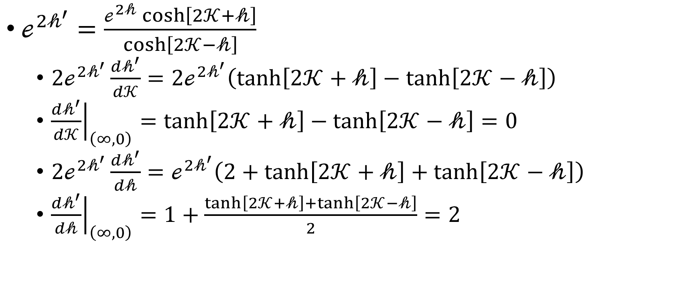
Example: one-dimensional Ising model
$ℯ^{2𝒽^{′}}=\frac{ℯ^{2𝒽}\cosh\left[2𝒦+𝒽\right]}{\cosh\left[2𝒦−𝒽\right]}$
$2ℯ^{2𝒽^{′}}\frac{d𝒽^{′}}{d𝒦}=2ℯ^{2𝒽^{′}}\left(\tanh\left[2𝒦+𝒽\right]−\tanh\left[2𝒦−𝒽\right]\right)$
${\left.\frac{d𝒽^{′}}{d𝒦}\right|}_{\left(∞,0\right)}=\tanh\left[2𝒦+𝒽\right]−\tanh\left[2𝒦−𝒽\right]=0$
$2ℯ^{2𝒽^{′}}\frac{d𝒽^{′}}{d𝒽}=ℯ^{2𝒽^{′}}\left(2+\tanh\left[2𝒦+𝒽\right]+\tanh\left[2𝒦−𝒽\right]\right)$
${\left.\frac{d𝒽^{′}}{d𝒽}\right|}_{\left(∞,0\right)}=1+\frac{\tanh\left[2𝒦+𝒽\right]+\tanh\left[2𝒦−𝒽\right]}{2}=2$

Slide 16
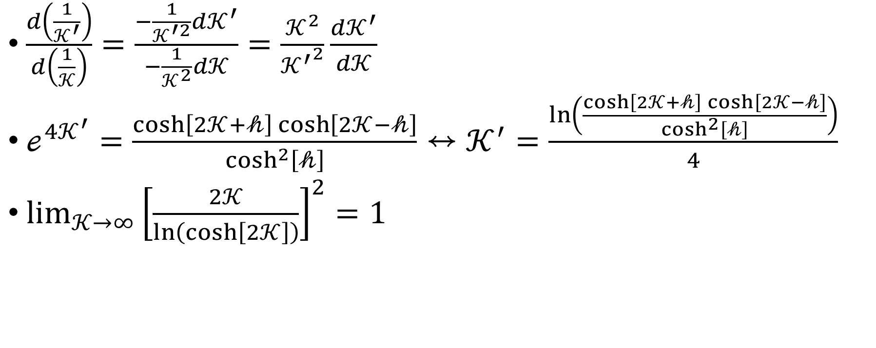
$\frac{d\left(\frac{1}{𝒦^{′}}\right)}{d\left(\frac{1}{𝒦}\right)}=\frac{−\frac{1}{𝒦^{′2}}d𝒦^{′}}{−\frac{1}{𝒦^{2}}d𝒦}=\frac{𝒦^{2}}{{𝒦^{′}}^{2}}\frac{d𝒦^{′}}{d𝒦}$
$ℯ^{4𝒦^{′}}=\frac{\cosh\left[2𝒦+𝒽\right]\cosh\left[2𝒦−𝒽\right]}{\cosh^{2}\left[𝒽\right]}↔𝒦^{′}=\frac{\ln\left(\frac{\cosh\left[2𝒦+𝒽\right]\cosh\left[2𝒦−𝒽\right]}{\cosh^{2}\left[𝒽\right]}\right)}{4}$
$\lim_{𝒦→∞}{{\left[\frac{2𝒦}{\ln\left(\cosh\left[2𝒦\right]\right)}\right]}^{2}}=1$

Slide 17
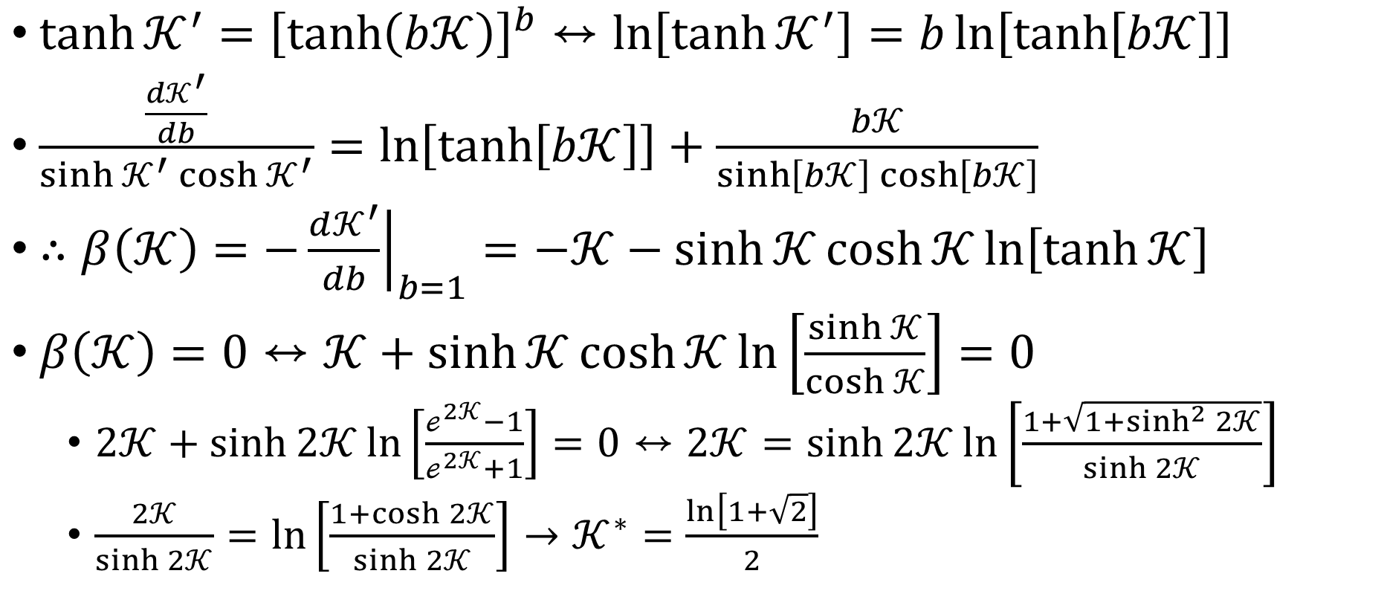
$\tanh{𝒦^{′}}={\left[\tanh\left(b𝒦\right)\right]}^{b}↔\ln\left[\tanh{𝒦^{′}}\right]=b\ln\left[\tanh\left[b𝒦\right]\right]$
$\frac{\frac{d𝒦^{′}}{db}}{\sinh{𝒦^{′}}\cosh{𝒦^{′}}}=\ln\left[\tanh\left[b𝒦\right]\right]+\frac{b𝒦}{\sinh\left[b𝒦\right]\cosh\left[b𝒦\right]}$
$∴β\left(𝒦\right)=−{\left.\frac{d𝒦^{′}}{db}\right|}_{b=1}=−𝒦−\sinh{𝒦}\cosh{𝒦}\ln\left[\tanh{𝒦}\right]$
$β\left(𝒦\right)=0↔𝒦+\sinh{𝒦}\cosh{𝒦}\ln\left[\frac{\sinh{𝒦}}{\cosh{𝒦}}\right]=0$
$2𝒦+\sinh{2𝒦}\ln\left[\frac{ℯ^{2𝒦}−1}{ℯ^{2𝒦}+1}\right]=0↔2𝒦=\sinh{2𝒦}\ln\left[\frac{1+\sqrt{1+\sinh^{2}{2𝒦}}}{\sinh{2𝒦}}\right]$
$\frac{2𝒦}{\sinh{2𝒦}}=\ln\left[\frac{1+\cosh{2𝒦}}{\sinh{2𝒦}}\right]→𝒦^{∗}=\frac{\ln\left[1+\sqrt{2}\right]}{2}$

Slide 18
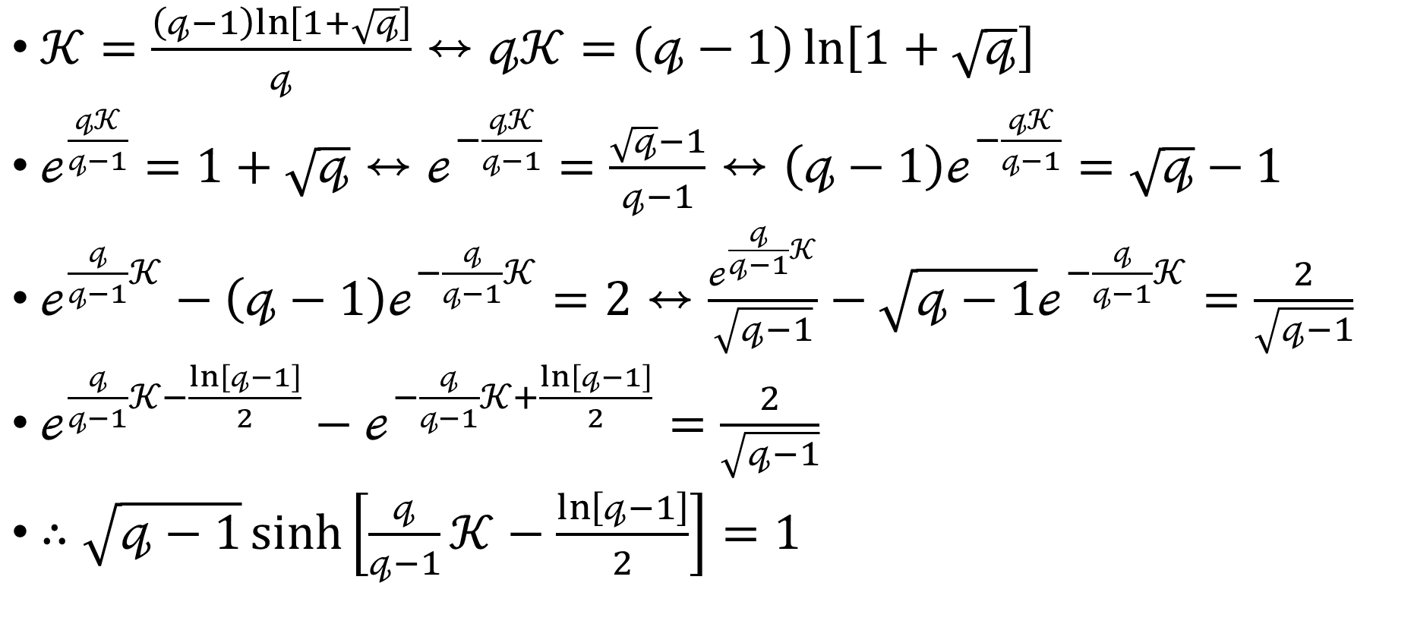
$𝒦=\frac{\left(𝓆−1\right)ln\left[1+\sqrt{𝓆}\right]}{𝓆}↔𝓆𝒦=\left(𝓆−1\right)\ln\left[1+\sqrt{𝓆}\right]$
$ℯ^{\frac{𝓆𝒦}{𝓆−1}}=1+\sqrt{𝓆}↔ℯ^{−\frac{𝓆𝒦}{𝓆−1}}=\frac{\sqrt{𝓆}−1}{𝓆−1}↔\left(𝓆−1\right)ℯ^{−\frac{𝓆𝒦}{𝓆−1}}=\sqrt{𝓆}−1$
$ℯ^{\frac{𝓆}{𝓆−1}𝒦}−\left(𝓆−1\right)ℯ^{−\frac{𝓆}{𝓆−1}𝒦}=2↔\frac{ℯ^{\frac{𝓆}{𝓆−1}𝒦}}{\sqrt{𝓆−1}}−\sqrt{𝓆−1}ℯ^{−\frac{𝓆}{𝓆−1}𝒦}=\frac{2}{\sqrt{𝓆−1}}$
$ℯ^{\frac{𝓆}{𝓆−1}𝒦−\frac{\ln\left[𝓆−1\right]}{2}}−ℯ^{−\frac{𝓆}{𝓆−1}𝒦+\frac{\ln\left[𝓆−1\right]}{2}}=\frac{2}{\sqrt{𝓆−1}}$
$∴\sqrt{𝓆−1}\sinh\left[\frac{𝓆}{𝓆−1}𝒦−\frac{\ln\left[𝓆−1\right]}{2}\right]=1$

Slide 19
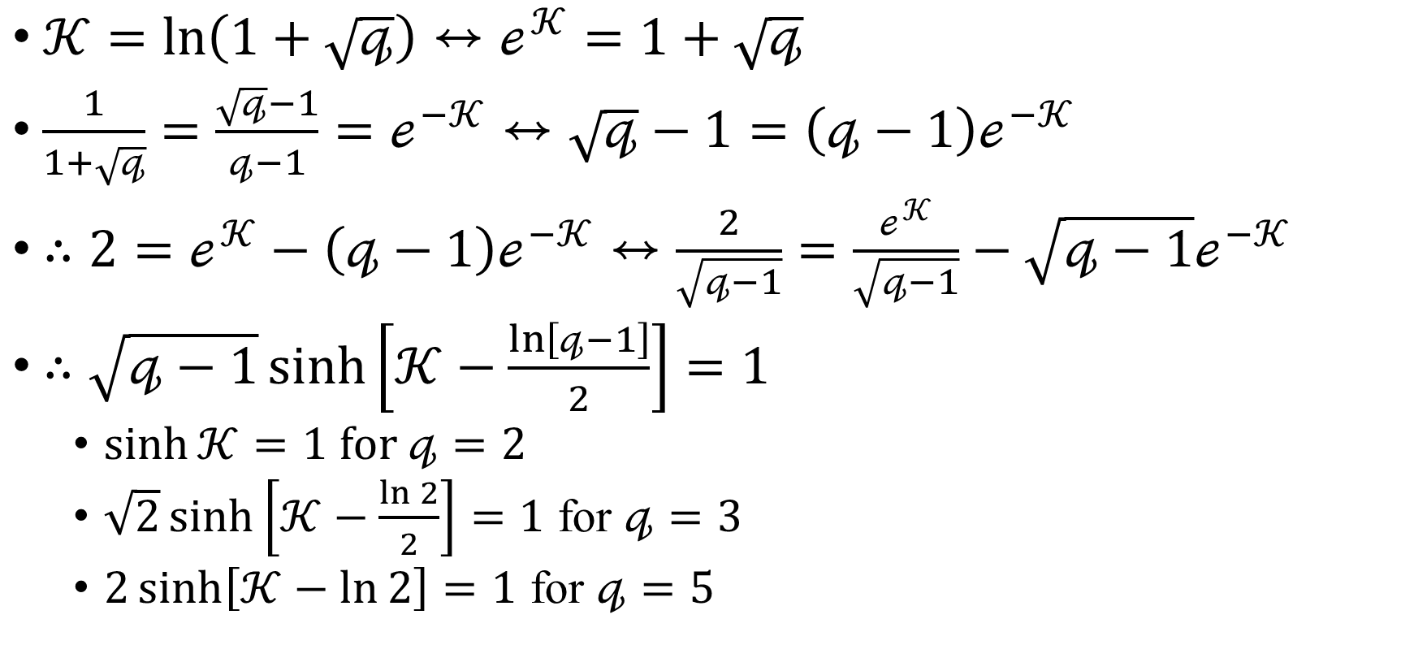
$𝒦=\ln\left(1+\sqrt{𝓆}\right)↔ℯ^{𝒦}=1+\sqrt{𝓆}$
$\frac{1}{1+\sqrt{𝓆}}=\frac{\sqrt{𝓆}−1}{𝓆−1}=ℯ^{−𝒦}↔\sqrt{𝓆}−1=\left(𝓆−1\right)ℯ^{−𝒦}$
$∴2=ℯ^{𝒦}−\left(𝓆−1\right)ℯ^{−𝒦}↔\frac{2}{\sqrt{𝓆−1}}=\frac{ℯ^{𝒦}}{\sqrt{𝓆−1}}−\sqrt{𝓆−1}ℯ^{−𝒦}$
$∴\sqrt{𝓆−1}\sinh\left[𝒦−\frac{\ln\left[𝓆−1\right]}{2}\right]=1$
$\sinh{𝒦}=1$ for $𝓆=2$
$\sqrt{2}\sinh\left[𝒦−\frac{\ln{2}}{2}\right]=1$ for $𝓆=3$
$2\sinh\left[𝒦−\ln{2}\right]=1$ for $𝓆=5$

Slide 20
Block-spin RG

Slide 21
Migdal-Kadanoff RG

Slide 22
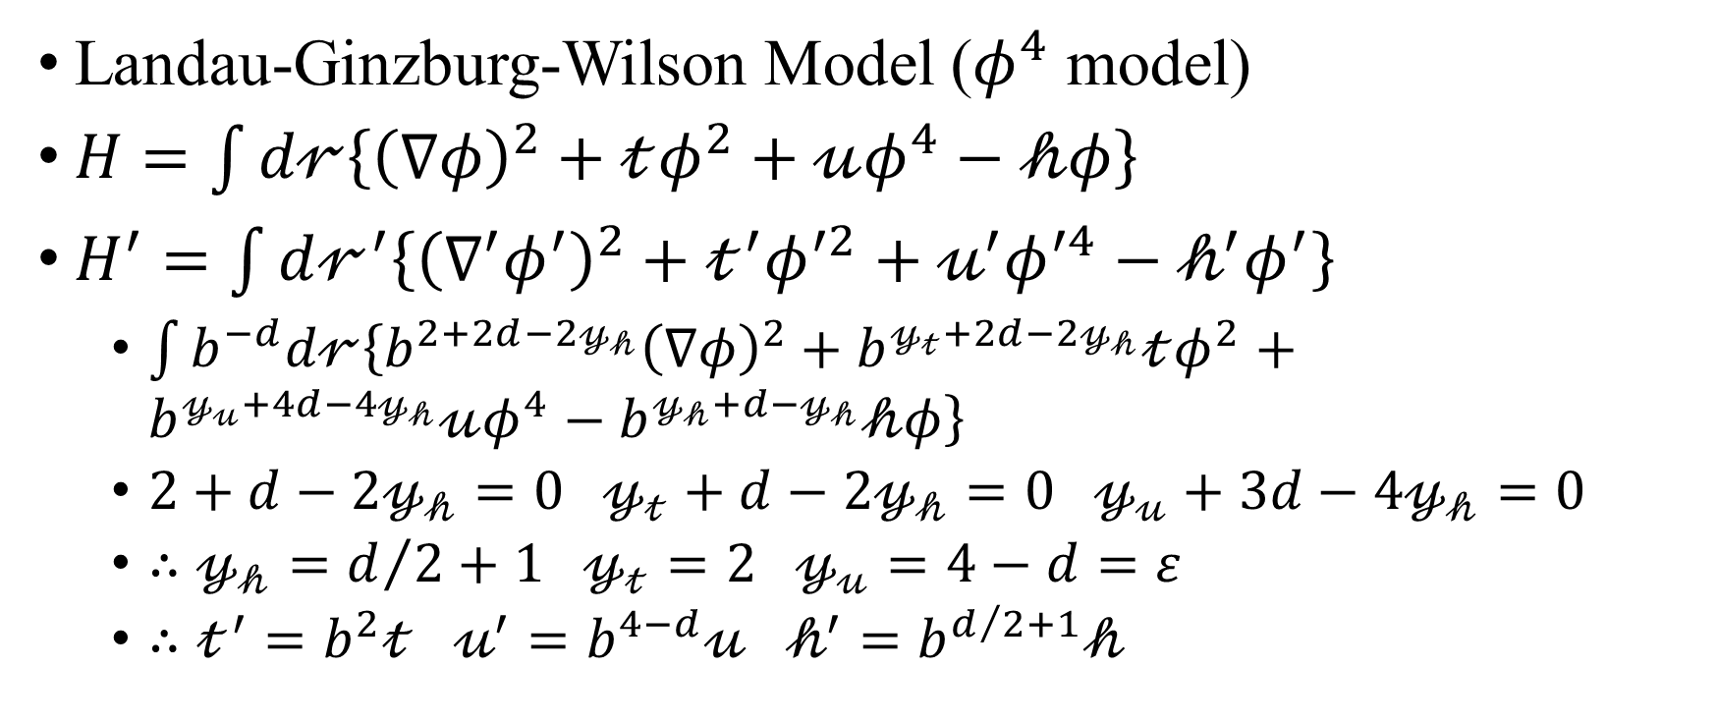
Momentum-space RG
Landau-Ginzburg-Wilson Model ($φ^{4}$ model)
$H=\int{d𝓇\left\{{\left(∇φ\right)}^{2}+𝓉φ^{2}+𝓊φ^{4}−𝒽φ\right\}}$
$H^{′}=\int{d𝓇^{′}\left\{{\left(∇^{′}φ^{′}\right)}^{2}+𝓉^{′}φ^{′2}+𝓊^{′}φ^{′4}−𝒽^{′}φ^{′}\right\}}$
$\int{b^{−d}d𝓇\left\{{b^{2+2d−2𝓎_{𝒽}}\left(∇φ\right)}^{2}+b^{𝓎_{𝓉}+2d−2𝓎_{𝒽}}𝓉φ^{2}+b^{𝓎_{𝓊}+4d−4𝓎_{𝒽}}𝓊φ^{4}−b^{𝓎_{𝒽}+d−𝓎_{𝒽}}𝒽φ\right\}}$
$2+d−2𝓎_{𝒽}=0 𝓎_{𝓉}+d−2𝓎_{𝒽}=0 𝓎_{𝓊}+3d−4𝓎_{𝒽}=0$
$∴𝓎_{𝒽}=d/2+1 𝓎_{𝓉}=2 𝓎_{𝓊}=4−d=ε$
$∴𝓉^{′}=b^{2}𝓉 𝓊^{′}=b^{4−d}𝓊 𝒽^{′}=b^{d/2+1}𝒽$

Slide 23
Quantum Phase Transition
Transverse-field Ising model

Slide 25
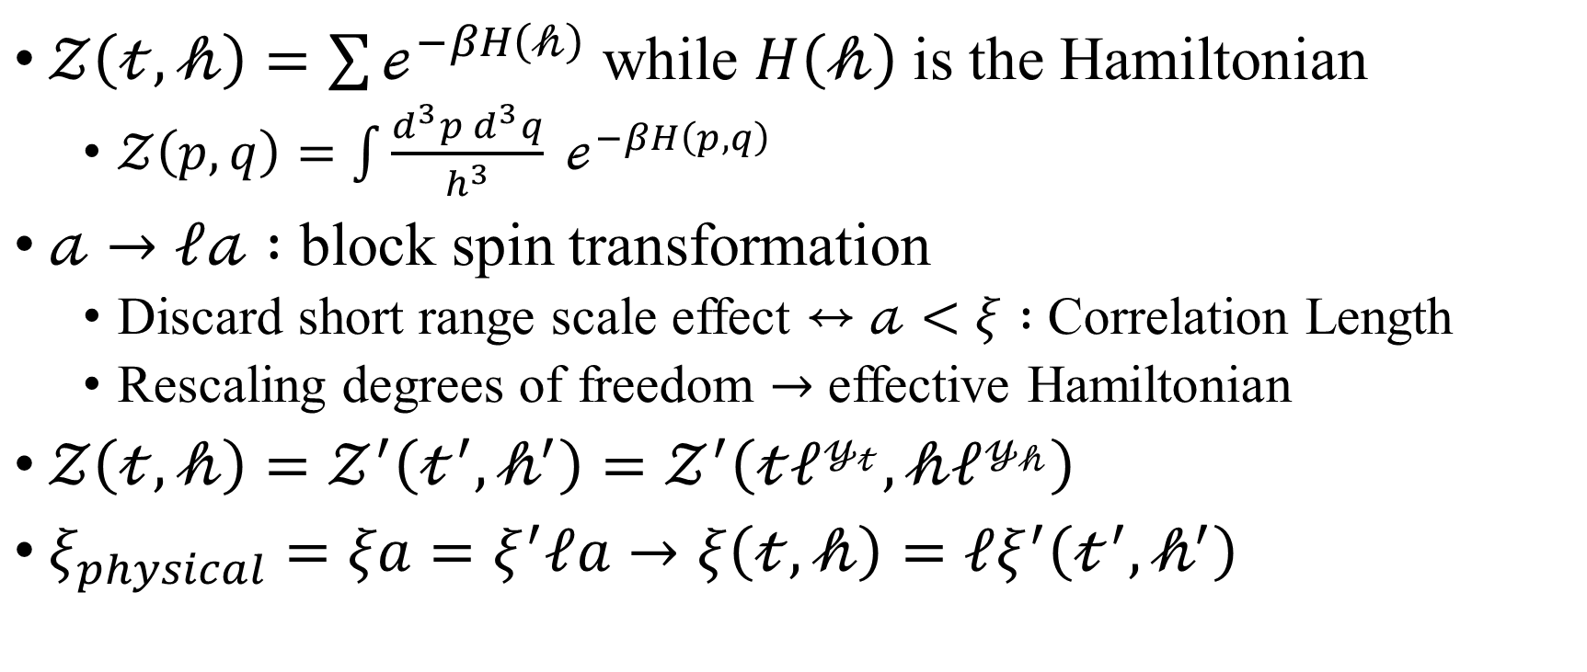

Partition Function $𝒵\left(𝓉,𝒽\right)$
$𝒵\left(𝓉,𝒽\right)=\sum{ℯ^{−βH\left(𝒽\right)}}$ while $H\left(𝒽\right)$ is the Hamiltonian
$𝒵\left(p,q\right)=\int{\frac{d^{3}p d^{3}q}{h^{3}} ℯ^{−βH\left(p,q\right)}}$
$𝒶→ℓ𝒶 :$ block spin transformation
Discard short range scale effect $↔$ $𝒶<ξ :$ Correlation Length
Rescaling degrees of freedom $→$ effective Hamiltonian
$𝒵\left(𝓉,𝒽\right)=𝒵^{′}\left(𝓉^{′},𝒽^{′}\right)=𝒵^{′}\left(𝓉ℓ^{𝓎_{𝓉}},𝒽ℓ^{𝓎_{𝒽}}\right)$
$ξ_{physical}=ξa=ξ^{′}ℓa→ξ\left(𝓉,𝒽\right)=ℓξ^{′}\left(𝓉^{′},𝒽^{′}\right)$

Slide 26
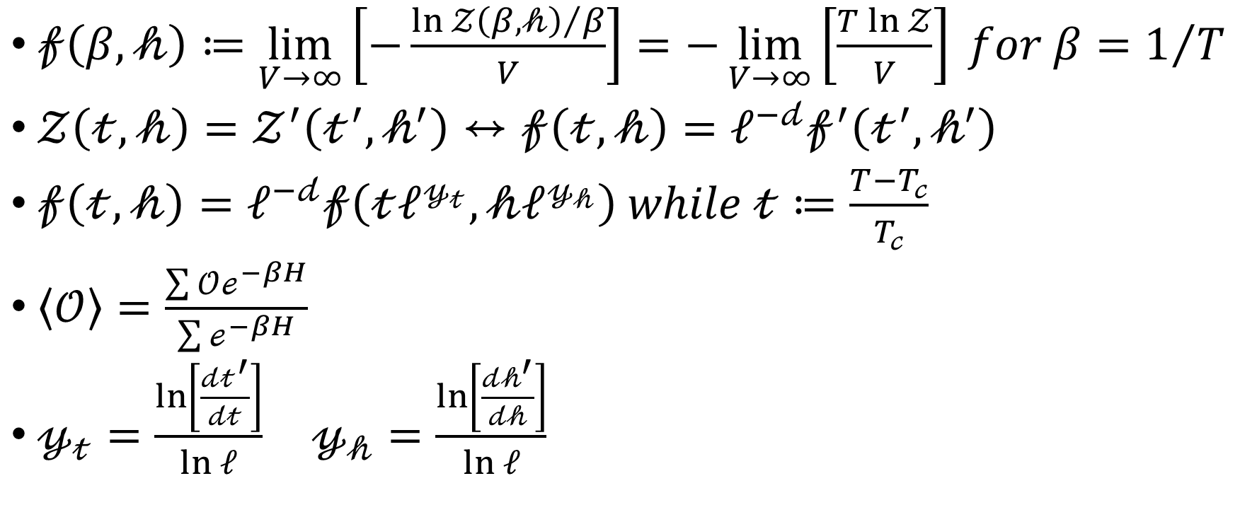

Bulk Free Energy Density $𝒻\left(𝓉,𝒽\right)$
$𝒻\left(β,𝒽\right)≔\lim_{V→∞}\left[−\frac{{\ln{𝒵\left(β, 𝒽\right)}}/β}{V}\right]=−\lim_{V→∞}\left[\frac{T\ln{𝒵}}{V}\right] for β=1/T$
$𝒵\left(𝓉,𝒽\right)=𝒵^{′}\left(𝓉^{′},𝒽^{′}\right)↔𝒻\left(𝓉,𝒽\right)=ℓ^{−𝒹}𝒻^{′}\left(𝓉^{′},𝒽^{′}\right)$
$𝒻\left(𝓉,𝒽\right)=ℓ^{−𝒹}𝒻\left(𝓉ℓ^{𝓎_{𝓉}},𝒽ℓ^{𝓎_{𝒽}}\right) while 𝓉≔\frac{T−T_{𝒸}}{T_{𝒸}}$
$\left\langle 𝒪\right\rangle =\frac{\sum{𝒪ℯ^{−βH}}}{\sum{ℯ^{−βH}}}$
$𝓎_{𝓉}=\frac{\ln\left[\frac{𝒹𝓉^{′}}{𝒹𝓉}\right]}{\ln{ℓ}} 𝓎_{𝒽}=\frac{\ln\left[\frac{𝒹𝒽^{′}}{𝒹𝒽}\right]}{\ln{ℓ}}$

Slide 27
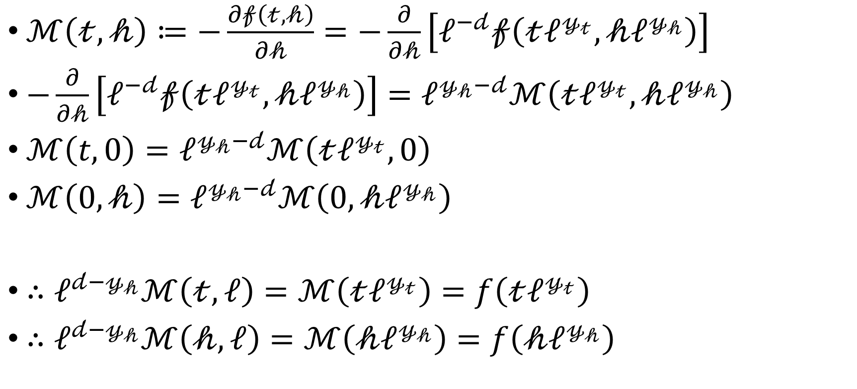
Finite Size Scaling, Order Parameter
$ℳ\left(𝓉,𝒽\right)≔−\frac{∂𝒻\left(𝓉,𝒽\right)}{∂𝒽}=−\frac{∂}{∂𝒽}\left[ℓ^{−𝒹}𝒻\left(𝓉ℓ^{𝓎_{𝓉}},𝒽ℓ^{𝓎_{𝒽}}\right)\right]$
$−\frac{∂}{∂𝒽}\left[ℓ^{−𝒹}𝒻\left(𝓉ℓ^{𝓎_{𝓉}},𝒽ℓ^{𝓎_{𝒽}}\right)\right]=ℓ^{𝓎_{𝒽}−𝒹}ℳ\left(𝓉ℓ^{𝓎_{𝓉}},𝒽ℓ^{𝓎_{𝒽}}\right)$
$ℳ\left(t, 0\right)=ℓ^{𝓎_{𝒽}−𝒹}ℳ\left(𝓉ℓ^{𝓎_{𝓉}},0\right)$
$ℳ\left(0,𝒽\right)=ℓ^{𝓎_{𝒽}−𝒹}ℳ\left(0,𝒽ℓ^{𝓎_{𝒽}}\right)$
$∴ℓ^{𝒹−𝓎_{𝒽}}ℳ\left(𝓉,ℓ\right)=ℳ\left(𝓉ℓ^{𝓎_{𝓉}}\right)=f\left(𝓉ℓ^{𝓎_{𝓉}}\right)$
$∴ℓ^{𝒹−𝓎_{𝒽}}ℳ\left(𝒽,ℓ\right)=ℳ\left(𝒽ℓ^{𝓎_{𝒽}}\right)=f\left(𝒽ℓ^{𝓎_{𝒽}}\right)$

Slide 28
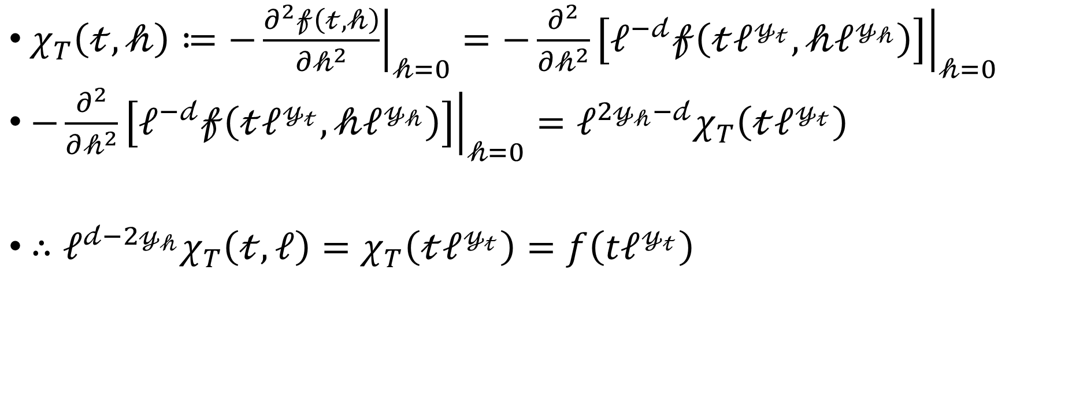
Finite Size Scaling, Susceptibility
$χ_{T}\left(𝓉,𝒽\right)≔−{\left.\frac{∂^{2}𝒻\left(𝓉,𝒽\right)}{∂𝒽^{2}}\right|}_{𝒽=0}=−{\left.\frac{∂^{2}}{∂𝒽^{2}}\left[ℓ^{−𝒹}𝒻\left(𝓉ℓ^{𝓎_{𝓉}},𝒽ℓ^{𝓎_{𝒽}}\right)\right]\right|}_{𝒽=0}$
$−{\left.\frac{∂^{2}}{∂𝒽^{2}}\left[ℓ^{−𝒹}𝒻\left(𝓉ℓ^{𝓎_{𝓉}},𝒽ℓ^{𝓎_{𝒽}}\right)\right]\right|}_{𝒽=0}=ℓ^{2𝓎_{𝒽}−𝒹}χ_{T}\left(𝓉ℓ^{𝓎_{𝓉}}\right)$
$∴ℓ^{𝒹−2𝓎_{𝒽}}χ_{T}\left(𝓉,ℓ\right)=χ_{T}\left(𝓉ℓ^{𝓎_{𝓉}}\right)=f\left(tℓ^{𝓎_{𝓉}}\right)$

Slide 29
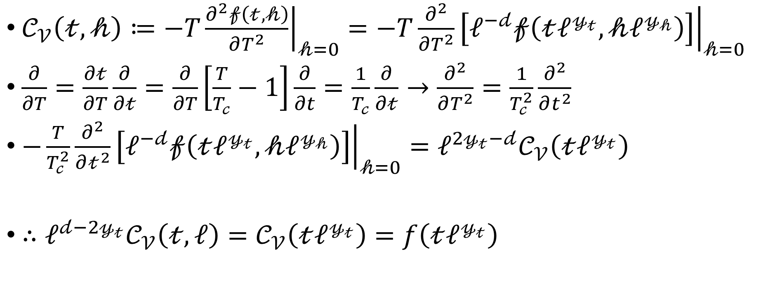
Finite Size Scaling, Specific Heat
$𝒞_{𝒱}\left(𝓉,𝒽\right)≔−T{\left.\frac{∂^{2}𝒻\left(𝓉,𝒽\right)}{∂T^{2}}\right|}_{𝒽=0}=−T{\left.\frac{∂^{2}}{∂T^{2}}\left[ℓ^{−𝒹}𝒻\left(𝓉ℓ^{𝓎_{𝓉}},𝒽ℓ^{𝓎_{𝒽}}\right)\right]\right|}_{𝒽=0}$
$\frac{∂}{∂T}=\frac{∂𝓉}{∂T}\frac{∂}{∂𝓉}=\frac{∂}{∂T}\left[\frac{T}{T_{𝒸}}−1\right]\frac{∂}{∂t}=\frac{1}{T_{𝒸}}\frac{∂}{∂𝓉}→\frac{∂^{2}}{∂T^{2}}=\frac{1}{T_{𝒸}^{2}}\frac{∂^{2}}{∂t^{2}}$
$−\frac{T}{T_{𝒸}^{2}}{\left.\frac{∂^{2}}{∂𝓉^{2}}\left[ℓ^{−𝒹}𝒻\left(𝓉ℓ^{𝓎_{𝓉}},𝒽ℓ^{𝓎_{𝒽}}\right)\right]\right|}_{𝒽=0}=ℓ^{2𝓎_{𝓉}−𝒹}𝒞_{𝒱}\left(𝓉ℓ^{𝓎_{𝓉}}\right)$
$∴ℓ^{𝒹−2𝓎_{𝓉}}𝒞_{𝒱}\left(𝓉,ℓ\right)=𝒞_{𝒱}\left(𝓉ℓ^{𝓎_{𝓉}}\right)=f\left(𝓉ℓ^{𝓎_{𝓉}}\right)$

Slide 30
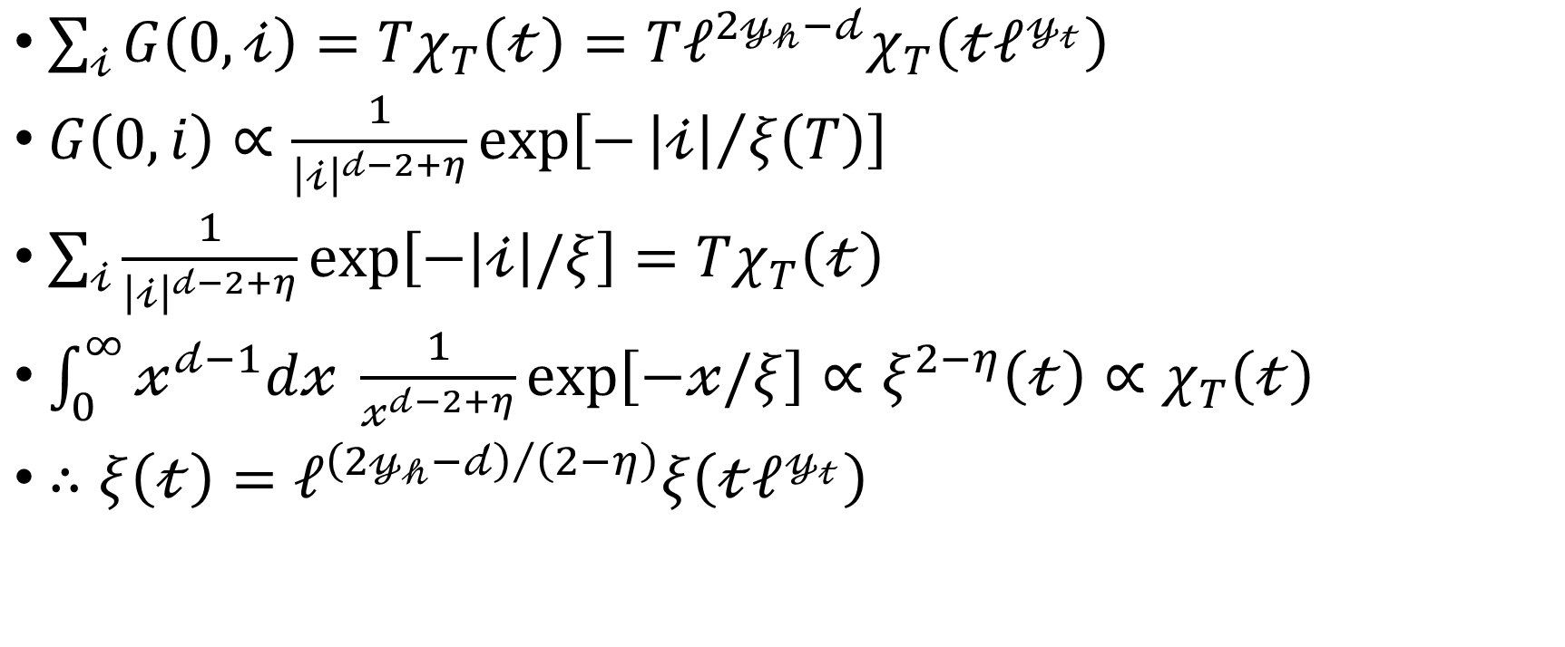
Correlation Function
$\sum_{𝒾}{G\left(0,𝒾\right)}=Tχ_{T}\left(𝓉\right)=Tℓ^{2𝓎_{𝒽}−𝒹}χ_{T}\left(𝓉ℓ^{𝓎_{𝓉}}\right)$
$G\left(0,i\right)∝\frac{1}{{\left|𝒾\right|}^{𝒹−2+η}}exp\left[−{\left|𝒾\right|}/{ξ\left(T\right)}\right]$
$\sum_{𝒾}{\frac{1}{{\left|𝒾\right|}^{𝒹−2+η}}\exp\left[−\left|𝒾\right|/ξ\right]}=Tχ_{T}\left(𝓉\right)$
$\int_{0}^{∞}{𝓍^{𝒹−1}d𝓍 \frac{1}{𝓍^{𝒹−2+η}}\exp\left[−𝓍/ξ\right]}∝ξ^{2−η}\left(𝓉\right)∝χ_{T}\left(𝓉\right)$
$∴ξ\left(𝓉\right)=ℓ^{{\left(2𝓎_{𝒽}−𝒹\right)}/{\left(2−η\right)}}ξ\left(𝓉ℓ^{𝓎_{𝓉}}\right)$

Slide 31
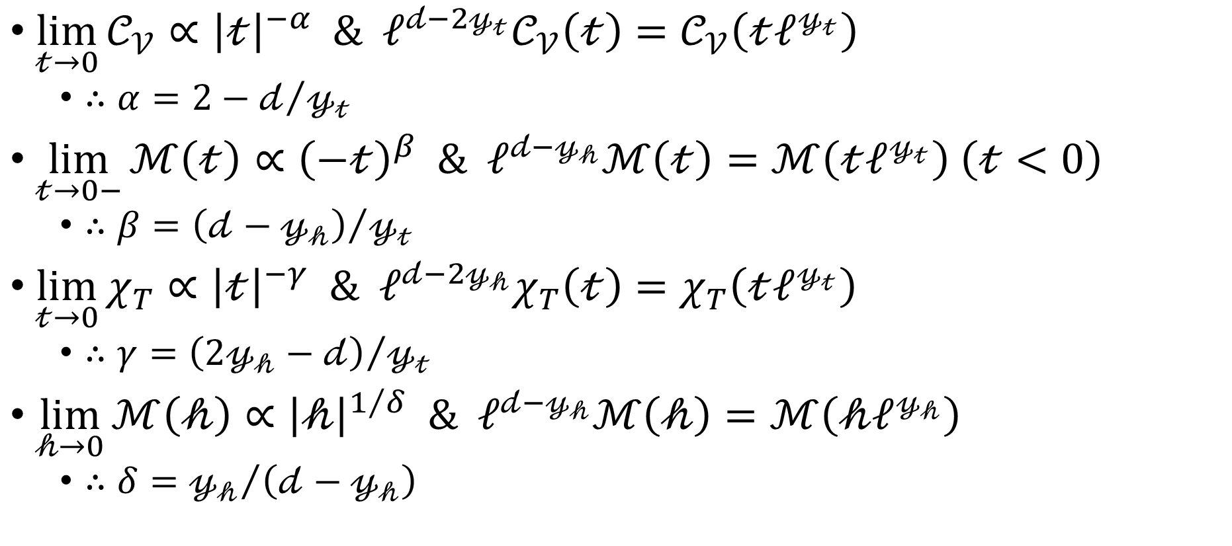
Scaling Relations
$\lim_{𝓉→0}{𝒞_{𝒱}}∝{\left|𝓉\right|}^{−α} \& ℓ^{𝒹−2𝓎_{𝓉}}𝒞_{𝒱}\left(𝓉\right)=𝒞_{𝒱}\left(𝓉ℓ^{𝓎_{𝓉}}\right)$
$∴α=2−𝒹/{𝓎_{𝓉}}$
$\lim_{𝓉→0−}{ℳ\left(𝓉\right)}∝{\left(−𝓉\right)}^{β} \& ℓ^{𝒹−𝓎_{𝒽}}ℳ\left(𝓉\right)=ℳ\left(𝓉ℓ^{𝓎_{𝓉}}\right) \left(𝓉<0\right)$
$∴β={\left(𝒹−𝓎_{𝒽}\right)}/{𝓎_{𝓉}}$
$\lim_{𝓉→0}{χ_{T}}∝{\left|𝓉\right|}^{−γ} \& ℓ^{𝒹−2𝓎_{𝒽}}χ_{T}\left(𝓉\right)=χ_{T}\left(𝓉ℓ^{𝓎_{𝓉}}\right)$
$∴γ={\left(2𝓎_{𝒽}−𝒹\right)}/{𝓎_{𝓉}}$
$\lim_{𝒽→0}{ℳ\left(𝒽\right)}∝{\left|𝒽\right|}^{1/δ} \& ℓ^{𝒹−𝓎_{𝒽}}ℳ\left(𝒽\right)=ℳ\left(𝒽ℓ^{𝓎_{𝒽}}\right)$
$∴δ={𝓎_{𝒽}}/{\left(𝒹−𝓎_{𝒽}\right)}$

Slide 32
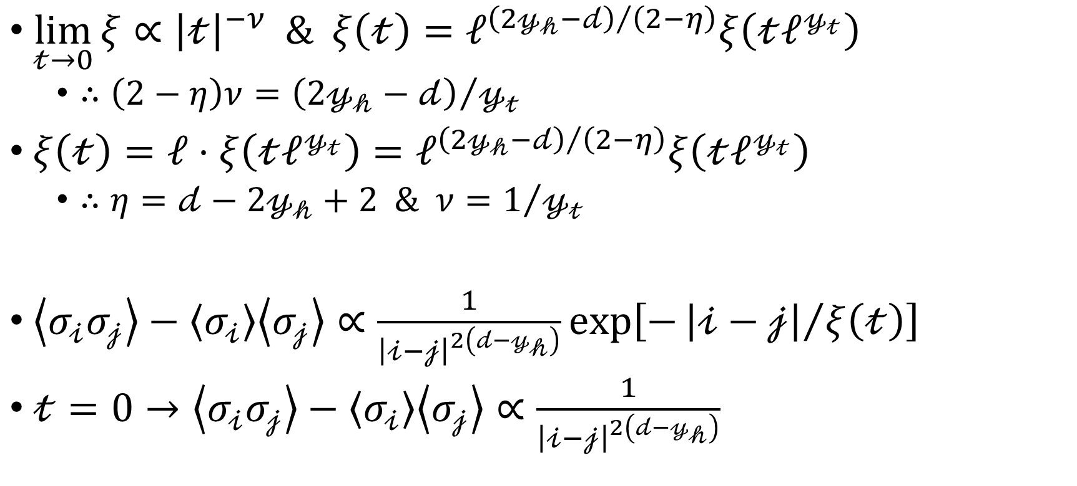
Scaling Relations
$\lim_{𝓉→0}{ξ}∝{\left|𝓉\right|}^{−ν} \& ξ\left(𝓉\right)=ℓ^{{\left(2𝓎_{𝒽}−𝒹\right)}/{\left(2−η\right)}}ξ\left(𝓉ℓ^{𝓎_{𝓉}}\right)$
$∴\left(2−η\right)ν={\left(2𝓎_{𝒽}−𝒹\right)}/{𝓎_{𝓉}}$
$ξ\left(𝓉\right)=ℓ⋅ξ\left(𝓉ℓ^{𝓎_{𝓉}}\right)=ℓ^{{\left(2𝓎_{𝒽}−𝒹\right)}/{\left(2−η\right)}}ξ\left(𝓉ℓ^{𝓎_{𝓉}}\right)$
$∴η=𝒹−2𝓎_{𝒽}+2 \& ν=1/{𝓎_{𝓉}}$
$\left\langle σ_{𝒾}σ_{𝒿}\right\rangle −\left\langle σ_{𝒾}\right\rangle \left\langle σ_{𝒿}\right\rangle ∝\frac{1}{{\left|𝒾−𝒿\right|}^{2\left(𝒹−𝓎_{𝒽}\right)}}exp\left[−{\left|𝒾−𝒿\right|}/{ξ\left(𝓉\right)}\right]$
$𝓉=0→\left\langle σ_{𝒾}σ_{𝒿}\right\rangle −\left\langle σ_{𝒾}\right\rangle \left\langle σ_{𝒿}\right\rangle ∝\frac{1}{{\left|𝒾−𝒿\right|}^{2\left(𝒹−𝓎_{𝒽}\right)}}$

Slide 33
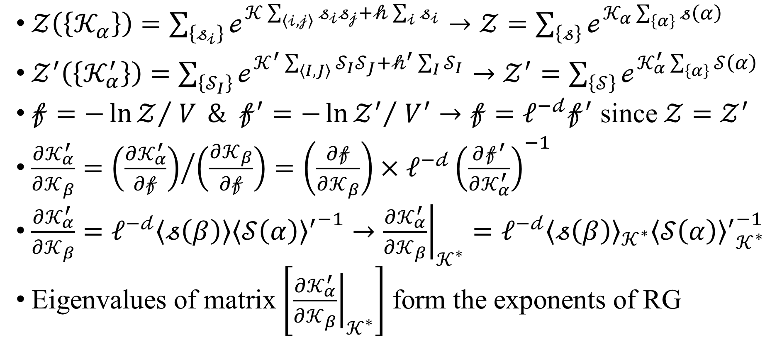
Monte Carlo Renormalization Group
$𝒵\left(\left\{𝒦_{α}\right\}\right)=\sum_{\left\{𝓈_{𝒾}\right\}}{ℯ^{𝒦\sum_{\left\langle 𝒾,𝒿\right\rangle }{𝓈_{𝒾}𝓈_{𝒿}}+𝒽\sum_{𝒾}{𝓈_{𝒾}}}}→𝒵=\sum_{\left\{𝓈\right\}}{ℯ^{𝒦_{α}\sum_{\left\{α\right\}}{𝓈\left(α\right)}}}$
$𝒵^{′}\left(\left\{𝒦_{α}^{′}\right\}\right)=\sum_{\left\{𝒮_{I}\right\}}{ℯ^{𝒦^{′}\sum_{\left\langle I,J\right\rangle }{𝒮_{I}𝒮_{J}}+𝒽^{′}\sum_{I}{𝒮_{I}}}}→𝒵^{′}=\sum_{\left\{𝒮\right\}}{ℯ^{𝒦_{α}^{′}\sum_{\left\{α\right\}}{𝒮\left(α\right)}}}$
$𝒻=−{\ln{𝒵}}/{ V} \& 𝒻^{′}=−{\ln{𝒵^{′}}}/{ V^{′}}→𝒻=ℓ^{−𝒹}𝒻^{′}$ since $𝒵=𝒵^{′}$
$\frac{∂𝒦_{α}^{′}}{∂𝒦_{β}}={\left(\frac{∂𝒦_{α}^{′}}{∂𝒻}\right)}/{\left(\frac{∂𝒦_{β}}{∂𝒻}\right)}=\left(\frac{∂𝒻}{∂𝒦_{β}}\right)×ℓ^{−𝒹}{\left(\frac{∂𝒻^{′}}{∂𝒦_{α}^{′}}\right)}^{−1}$
$\frac{∂𝒦_{α}^{′}}{∂𝒦_{β}}=ℓ^{−𝒹}\left\langle 𝓈\left(β\right)\right\rangle {{\left\langle 𝒮\left(α\right)\right\rangle }^{′}}^{−1}→{\left.\frac{∂𝒦_{α}^{′}}{∂𝒦_{β}}\right|}_{𝒦^{∗}}=ℓ^{−𝒹}{\left\langle 𝓈\left(β\right)\right\rangle }_{𝒦^{∗}}{{\left\langle 𝒮\left(α\right)\right\rangle }^{′}}_{𝒦^{∗}}^{−1}$
Eigenvalues of matrix $\left[{\left.\frac{∂𝒦_{α}^{′}}{∂𝒦_{β}}\right|}_{𝒦^{∗}}\right]$ form the exponents of RG

